Slide 1


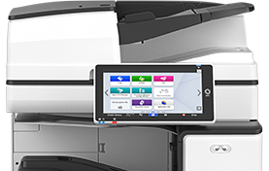
ECU PRINT
Personal Windows Laptop
Installation
If you need assistance with this process, please submit a help request or visit the Service Desk at the ECU Library and ask for assistance.

Slide 2
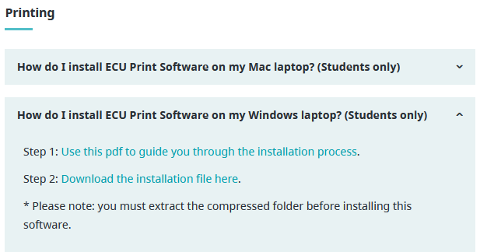
Install ECU Printing Software
on a Personal Windows Laptop
Installing the ECU Printing Software on your Windows Computer:
It is recommended to restart your Windows Laptop before installing the ECU Printing software.
Ensure your laptop is connected to the secure ECU Student Wi-Fi, or if you are Staff or Faculty, ECUAD Wi-Fi, not the guest Wi-Fi, and that you know your myEC User Name & Password.
Open an internet browser window and type: https://www.ecuad.ca/about/administration/itservices/services
Locate the link to the installation file in the "How do I install ECU Print Software on my Windows laptop?" drop-down box within the Printing section. Click the link and allow your browser to download the installer

Slide 3
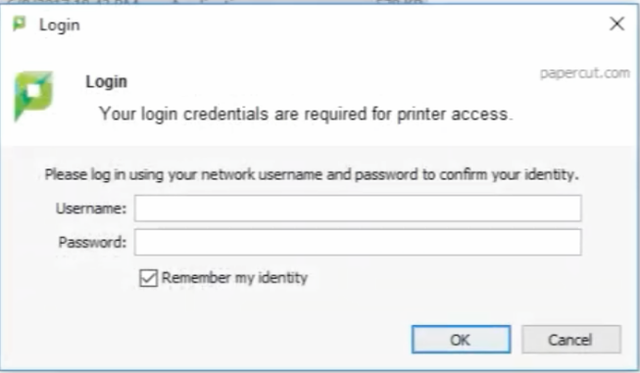
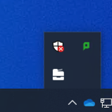
Install ECU Printing Software
on a Personal Windows Laptop
5. When the download is complete, un-compress the folder using Extract All. From the un-compressed folder, run the file called PaperCut Client install
6. Use the defaults when running the installer – you do not need to make any changes. You will need to enter your computer password to complete the install
7. After clicking Finish, you need to open the program in the Start menu. Look for the application called PaperCut MF Client. A pop-up will then appear. You must enter your MyEC username & password and check off “Remember my identity” before clicking OK.
* Once installed and run, the PCClient icon (green P) will appear in the applications menu at the bottom right-hand corner, (view hidden icons by clicking the up arrow at the bottom right tool bar). It needs to be running if you want to print, so ensure the icon is visible.
la

Slide 4
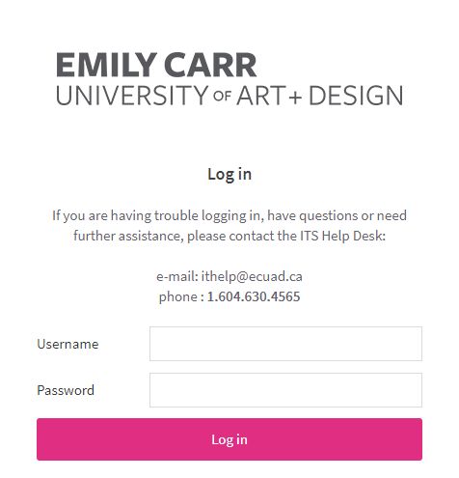
Install ECU Printing Software
on a Personal Windows Laptop
Installing the ECU Printers on your Windows Computer
1. To install the ECU printers themselves on your windows computer, start by logging into your ECU Print account; Open a browser and type in: print.ecuad.ca
2. Log into your ECU Print account by entering your myEC User Name & Password.
3. In the account menu, locate and click “Print Deploy”

Slide 5
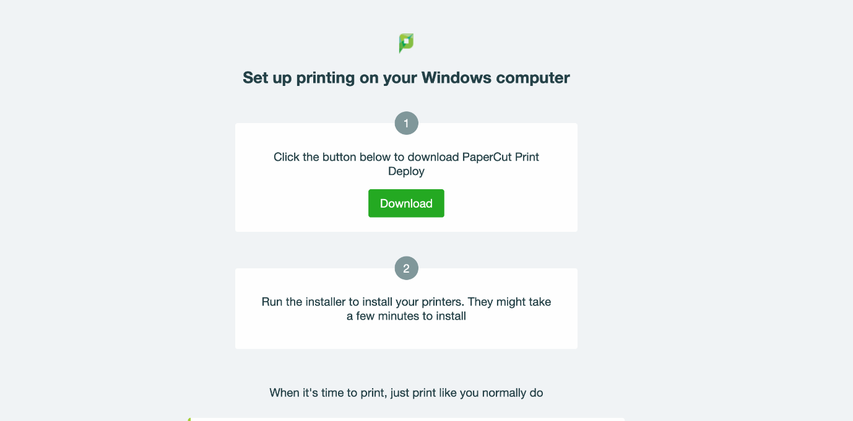
Install ECU Printing Software
on a Personal Windows Laptop
4. You will be redirected to a page with a list of links, select windows.html
5. When the Set up printing page opens, click Download and then RUN the downloaded program
la

Slide 6
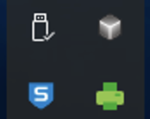
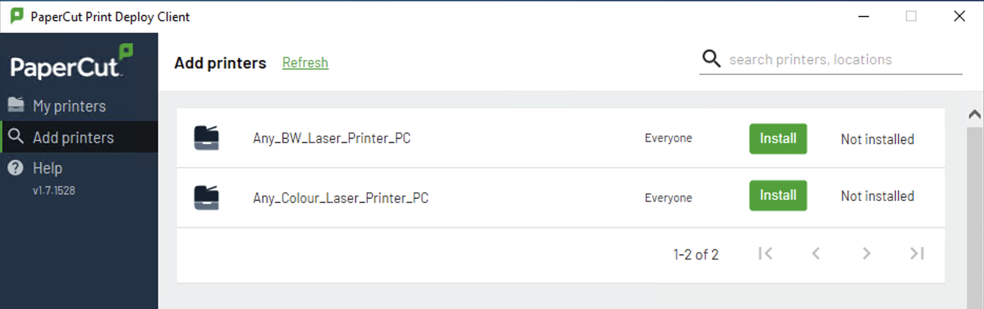
Install ECU Printing Software
on a Personal Windows Laptop
6. Once installed, the Papercut Print Deploy icon (green printer) will appear in the applications menu at the bottom right-hand corner (view hidden icons by clicking the up arrow at the bottom right tool bar). If the Print Deploy Icon is not present, you will need to restart your computer to complete the install.
7. Right click on the Print Deploy icon and select View my printers.
8. Select Add printers from the left menu bar and then Install the Any_BW_Laser_Printer_PC & Any_Colour_Laser_Printer_PC *install one printer at a time.
9. You can view the list of printers installed on your computer by selecting My printers in the left menu bar.

